Slide 1





MOVIE PROJECT
Presented By: Group 3

Slide 2



OUR TEAM
Timofei Semenov
Mark Kim
Reynard Milson
Khang Huynh

Slide 3
INTRODUCTION
Our team structured its effort to directly align with the project's Service-Oriented Architecture, requiring a dedicated focus on specialized areas. This collaborative approach involved one part of the team concentrating exclusively on developing the secure Authentication Service and the intricate JWT token flow. At the same time, the other managed the scalable Movies Service API and the complete frontend view layer. This clear division of labour was fundamental to overcoming the inherent complexities of building a distributed system, ensuring the seamless integration and high-level security of all independent services.

Slide 4
PROJECT GOALS
Empower users to create and manage a personal movie library. This involves features allowing users to register, log in, and perform full CRUD (Create, Read, Update, Delete) operations on their own movie entries.
1
Provide a collaborative and searchable movie discovery platform. This allows any visitor to browse, search (by title or description), and filter (by genre or year) the entire database of movies contributed by all users, making it a community-driven discovery tool.
2

Slide 5
KEY FEATURES
1
Complete User Authentication
3
Advanced Movie Discovery
2
Personal Movie Library Management
4
Scalable Microservices Architecture

Slide 6
TECHNOLOGIES USED
Node.js & Express.js
MongoDB & Mongoose
Pug, HTML, CSS, JavaScript
JWT & Bcrypt.js

Slide 7
DEMOSTRATION

Slide 8
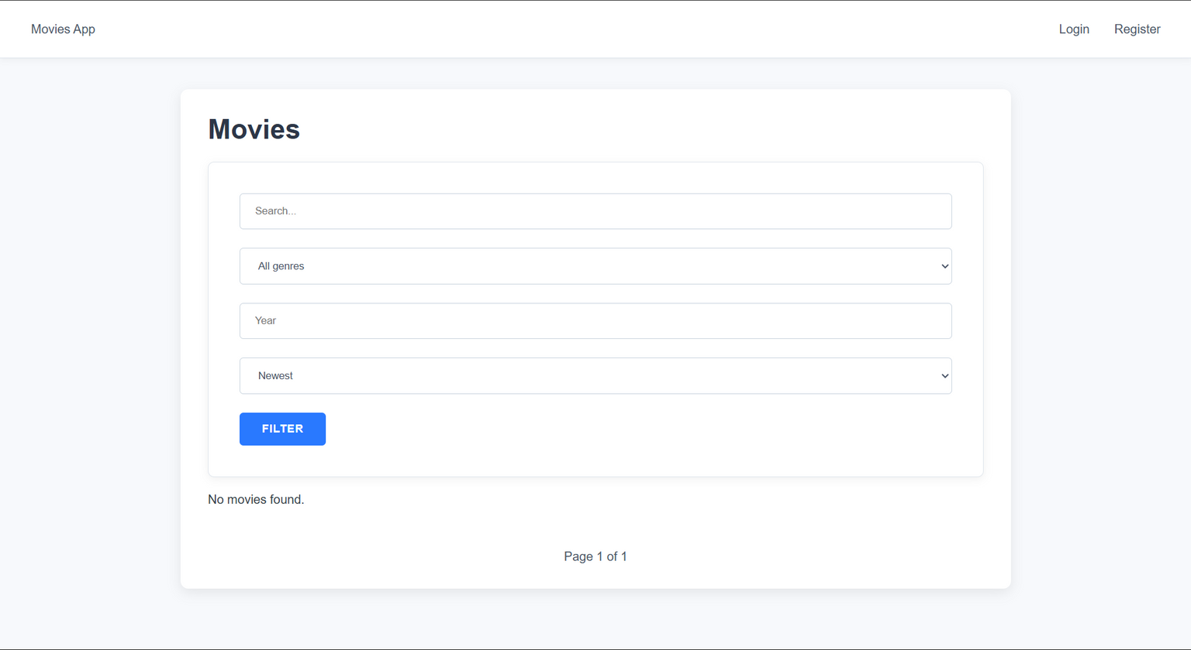
First, the user will land on the home page of the entire app, featuring a movie searcher.

Slide 9
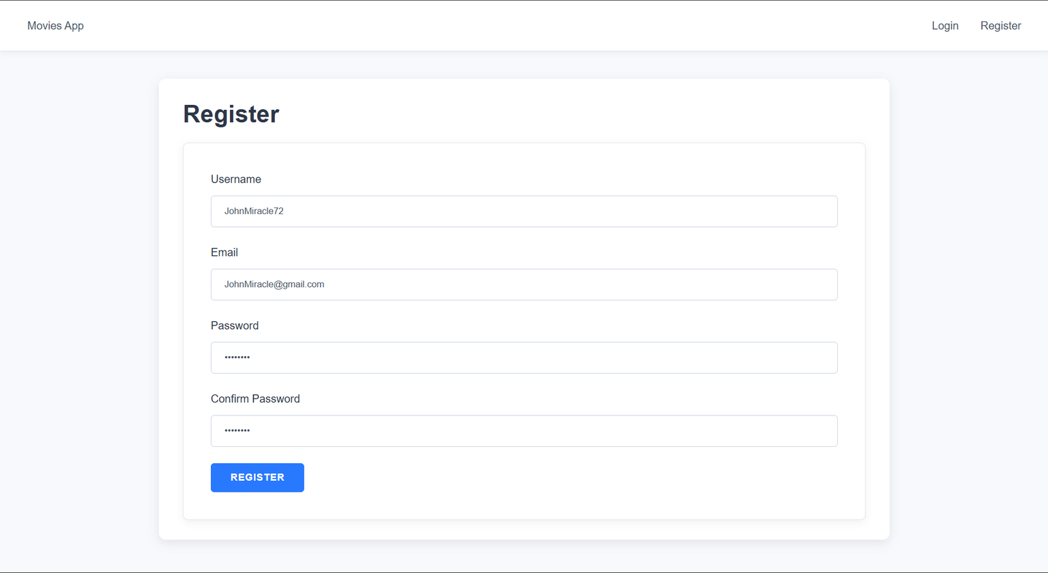
The user can register if they are a new user

Slide 10
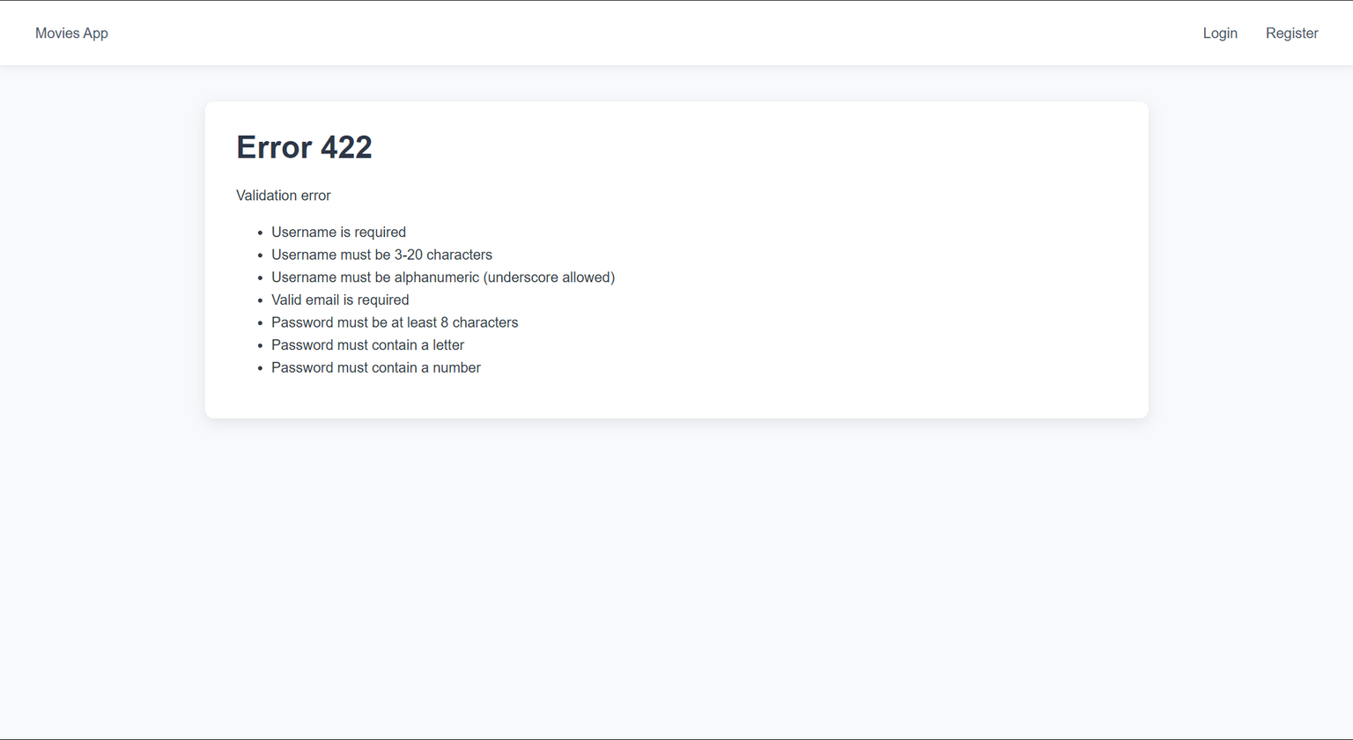
There are validations for the user registration

Slide 11
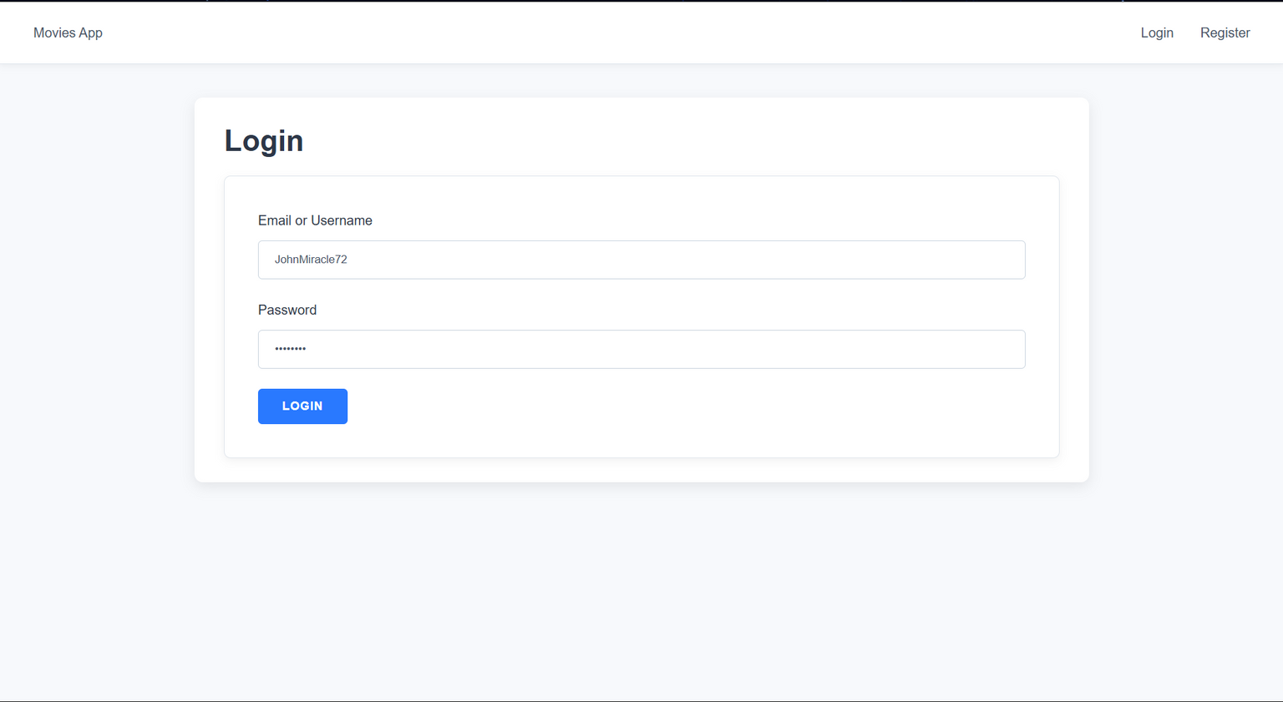
The user can log in again if they are already register

Slide 12
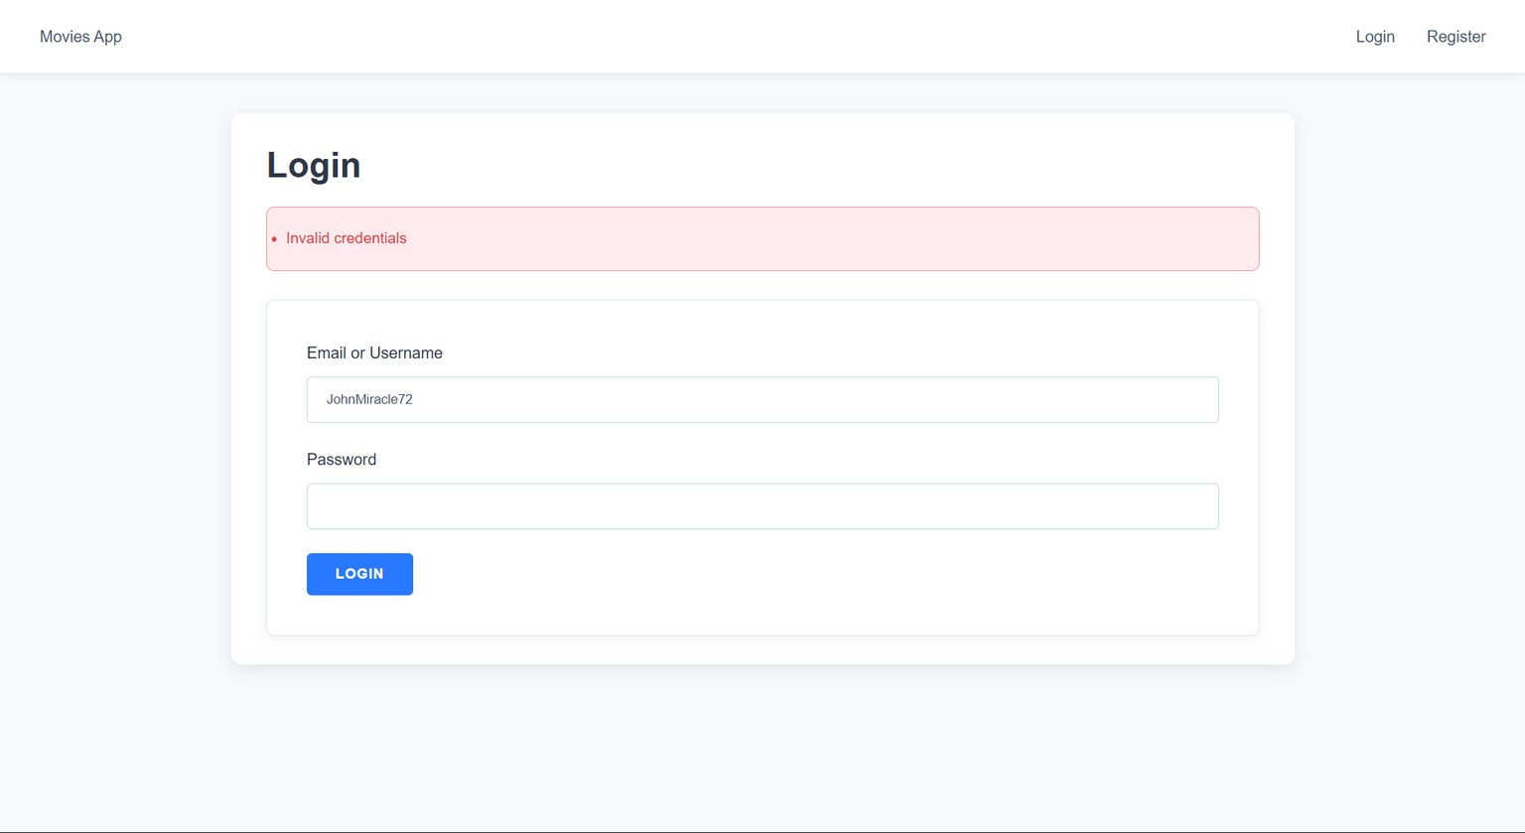
There are also credentials for the log in!

Slide 13
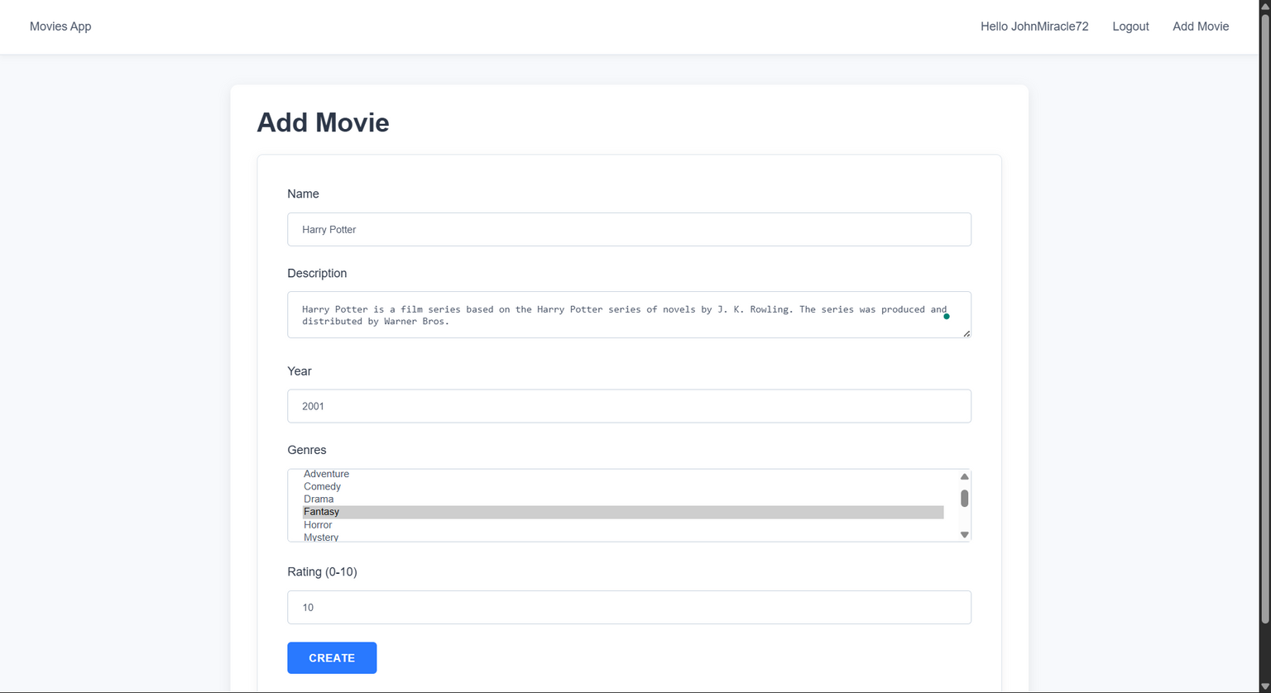
The user can now add their movie if they are logged in

Slide 14
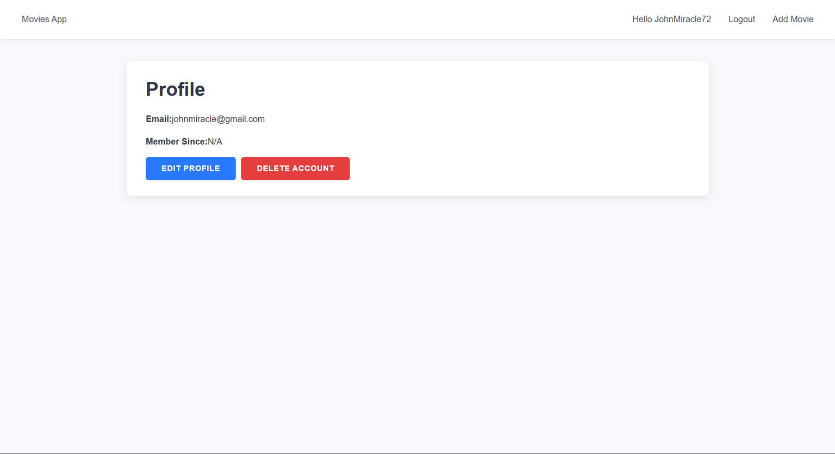
The user can also edit their profile

Slide 15
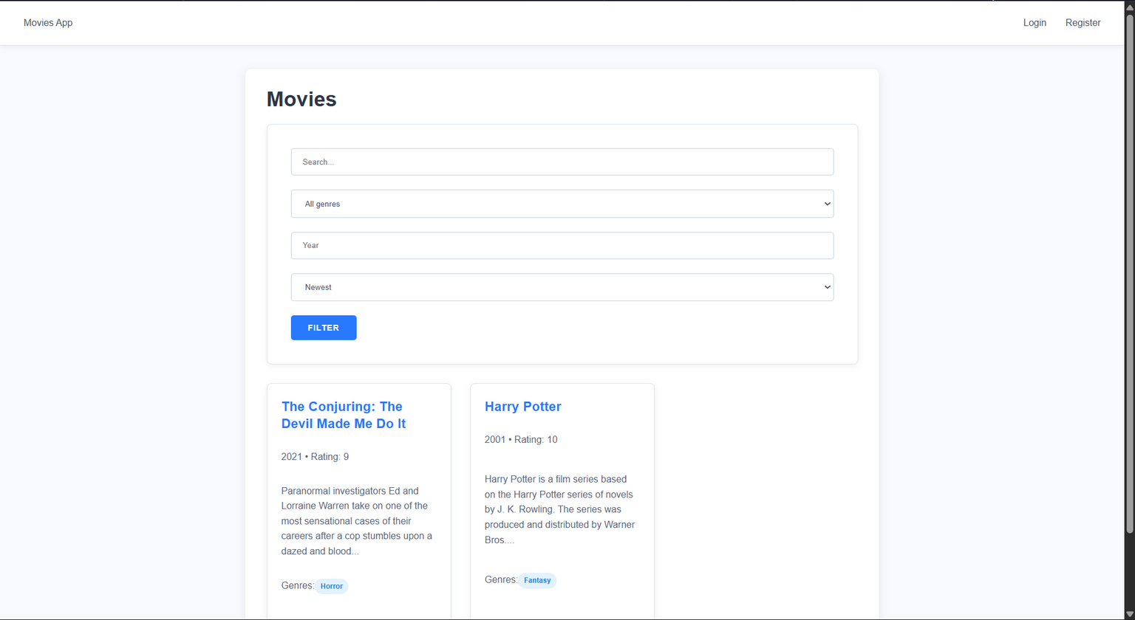
The movies are now there even if the user logs out, and others can also see them.

Slide 16
RESULT
The result is a fully functional, multi-user web application that acts as both a personal movie organizer and a collaborative movie discovery platform.
Ultimately, the project delivers:
1. For Registered Users: A secure, personal space to create, manage, and track their own movie library online.
2. For All Visitors: A rich, searchable, and filterable database of movies populated by the community, allowing anyone to discover new films.
Technically, the result is a scalable and maintainable application built on a modern microservices architecture, where different parts of the system (user management, movie data, and the user interface) operate independently.

Slide 17
CONCLUSION
In conclusion, this project successfully delivers a robust, microservices-based movie catalogue application. It effectively meets its two primary goals:
Providing users with a tool for personal movie library management while also creating a collaborative platform for movie discovery.
By leveraging a modern tech stack including Node.js, Express, and MongoDB, the application is not only functional but also scalable and maintainable. It stands as a complete proof-of-concept for a community-driven database where users can both manage their personal collections and contribute to a larger, shared resource for all film enthusiasts to explore.

Slide 18
THANK YOU
For Your Attention

